Slide 1
Aircraft Pitch Control via Traditional and Intelligent Methods
MECH6910T Mid-Project Presentation
Alfiyandy HARIANSYAH
mahariansyah@connect.ust.hk
26-Nov-2024
THE HONG KONG UNIVERSITY OF SCIENCE AND TECHNOLOGY
DEPARTMENT OF MECHANICAL AND AEROSPACE ENGINEERING

Slide 2
Introduction

Slide 3
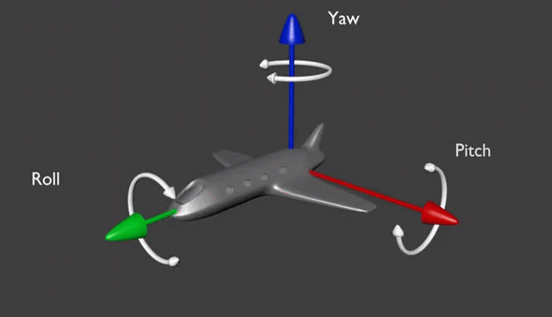
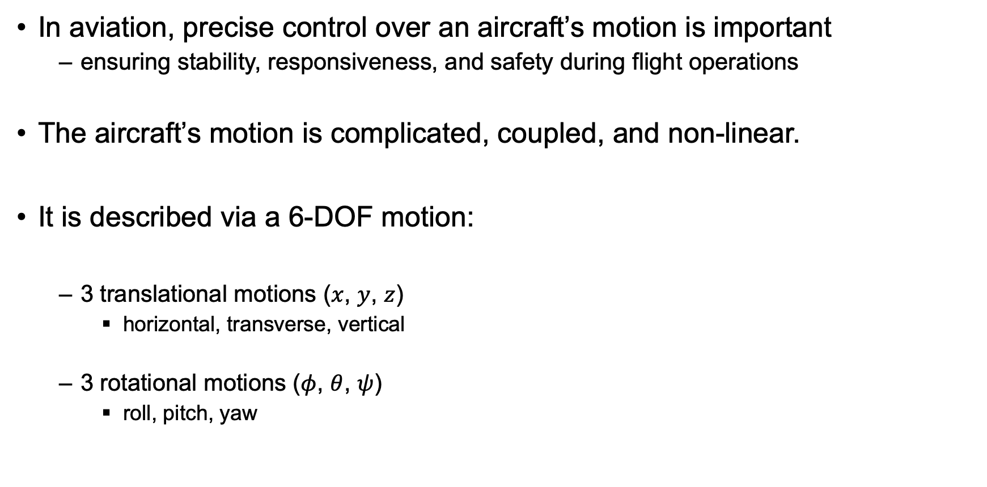
Introduction: aircraft’s motion
In aviation, precise control over an aircraft’s motion is important
ensuring stability, responsiveness, and safety during flight operations
The aircraft’s motion is complicated, coupled, and non-linear.
It is described via a 6-DOF motion:
3 translational motions ($x$, $y$, $z$)
horizontal, transverse, vertical
3 rotational motions ($φ$, $θ$, $ψ$)
roll, pitch, yaw
(https://pale.blue/2019/09/05/when-simulation-starts-with-motion/)

Slide 4
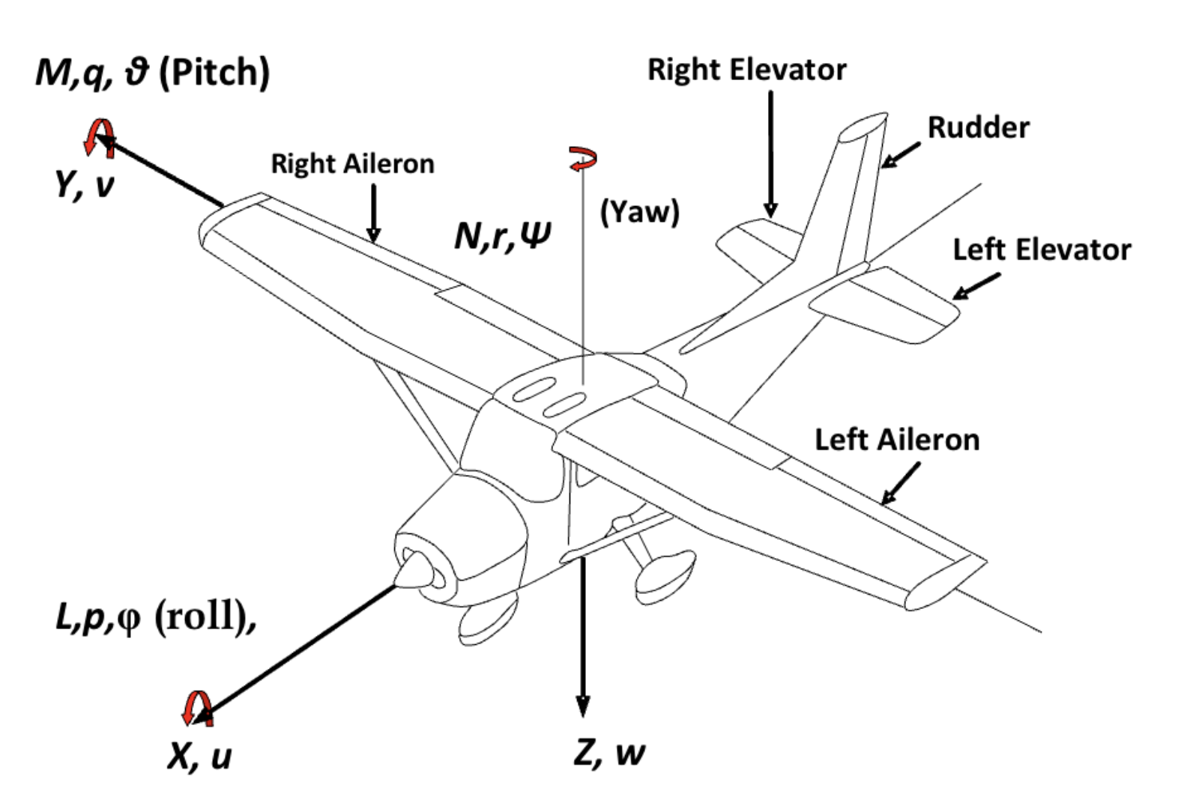
Introduction: aircraft’s control
The control over the aircraft’s motions is achieved by:
deflecting control surfaces: elevator, aileron, rudder
regulating throttle
Two uncoupled motions and controls:
longitudinal motion
states: pitch angle and velocity
controls: elevator and throttle
lateral motion
states: roll and yaw angles
controls: aileron and rudder
We focus only on longitudinal motion
Typical aircraft motion with control surfaces
(Aliyu et al., 2015)

Slide 5
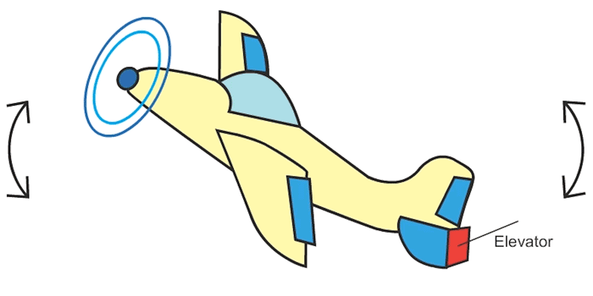
Introduction: aircraft pitch control
When an aircraft needs to climb or descend, it must pitch up/down.
it is thus important to develop a controller for achieving the desired pitch angle
In this project, aircraft pitch control is achieved by:
deflecting the elevator up/down
keeping the thrust constant
Project specification
Aircraft: Cessna-172
Motion: longitudinal-only
Control methods:
traditional: static PID control
intelligent: reinforcement learning
Aircraft pitch control
by deflecting the elevator
(google.com)

Slide 6
Literature review
Aircraft pitch control is not a new problem.
Others have developed traditional controllers:
Deepa et al., 2016: Proportional-Integral-Derivative
Vishal et al., 2014: Linear-Quadratic-Regulator
Arrosida et al., 2017: Observer-State-Feedback
Recent works attempted intelligent methods:
Wahid et al., 2012: Fuzzy PID
Liang et al., 2024: Artificial Neural Network
Richter et al., 2024: Reinforcement Learning
This project tries a new method: PID + Reinforcement Learning
static gains
adaptive gains

Slide 7
Motivation: PID + RL
PID + RL → PID with adaptive gain tuning by reinforcement learning
The idea of adaptive tuning is not new, but few have attempted reinforcement learning algorithms (e.g., DDPG) to tune the PID gains specifically for aircraft pitch control.
Adaptive tuning means the PID gains are changing over time.
Why adaptive tuning?
Traditional PID with static gains might only be good at specific flight conditions
Robust across various flight conditions even in the event of a disturbance, e.g, gusts

Slide 8
Methodologies

Slide 9
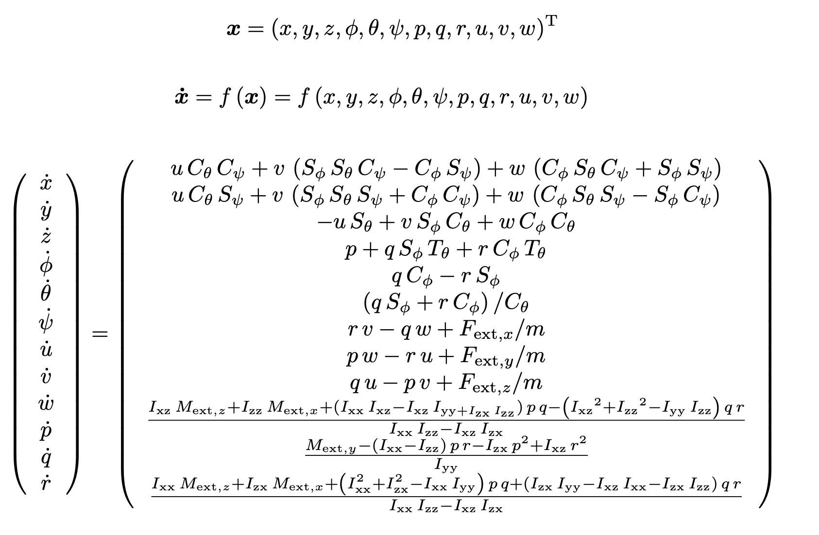
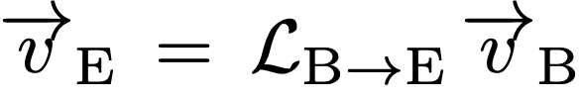
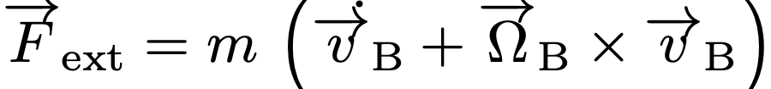
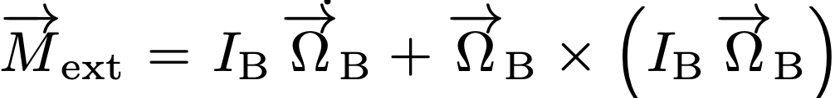
Non-linear coupled 6-DOF aircraft motion
12 state variables
body-to-earth velocities
body-to-earth angular rates
translational force equations
rotational moment equations

Slide 10
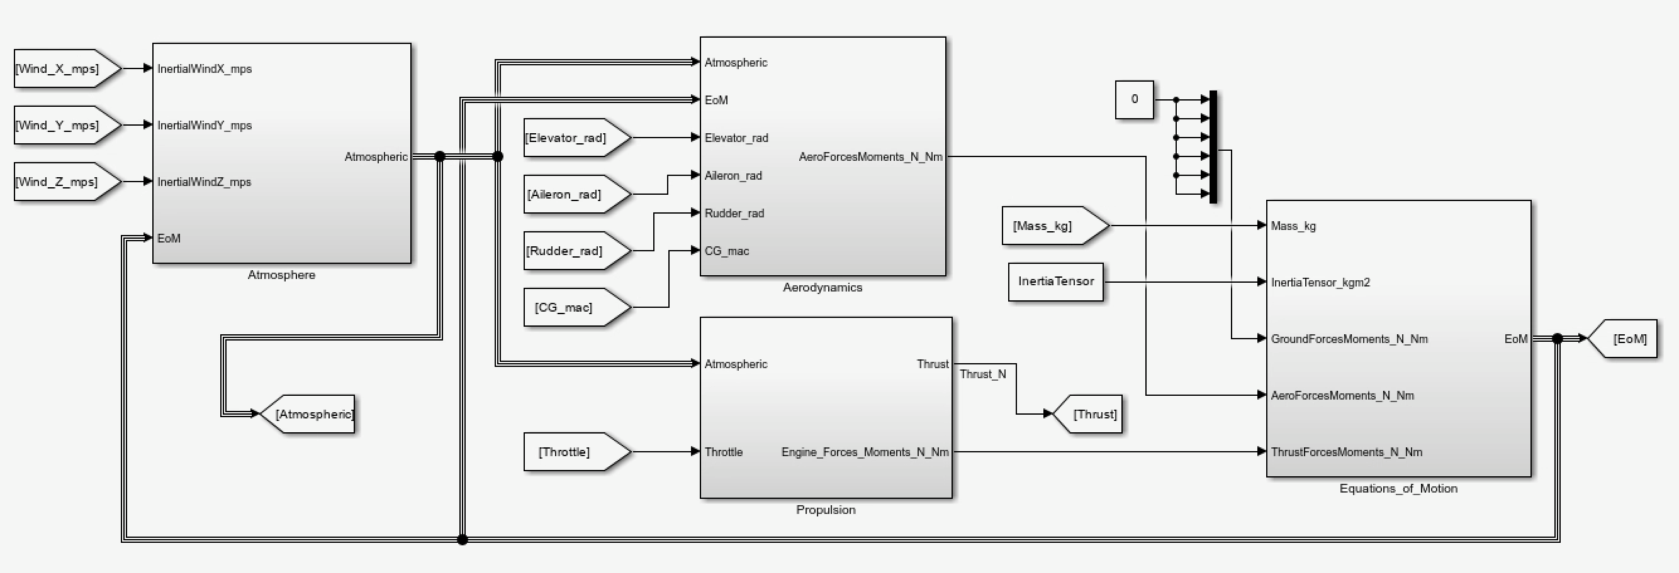
Simulink implementation
Four modules developed from scratch
Atmosphere : models the air using international standard atmosphere (ISA)
Aerodynamics : models the aerodynamics using published derivative values
Propulsion : models the generic propulsion
Equations_of_Motion : models the non-linear coupled 6-DOF aircraft motion

Slide 11
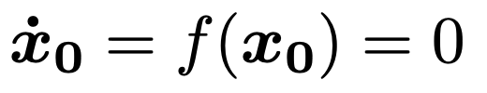
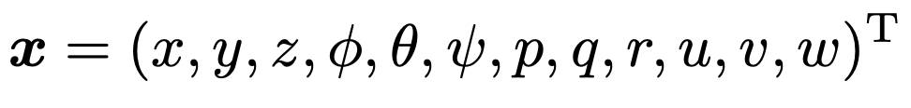
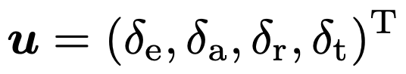
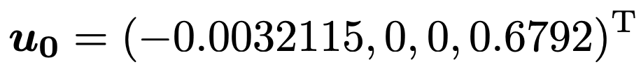
Trim condition
Assumption → level unaccelerated flight at 5000 ft.
The trim condition solves:
I used the Matlab trim function to solve these equations
12 state variables
4 control variables
trimmed state values
trimmed control values

Slide 12
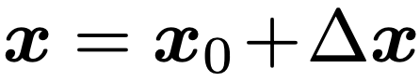
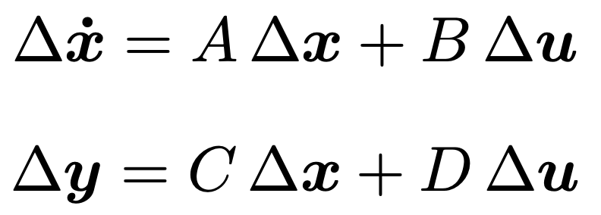
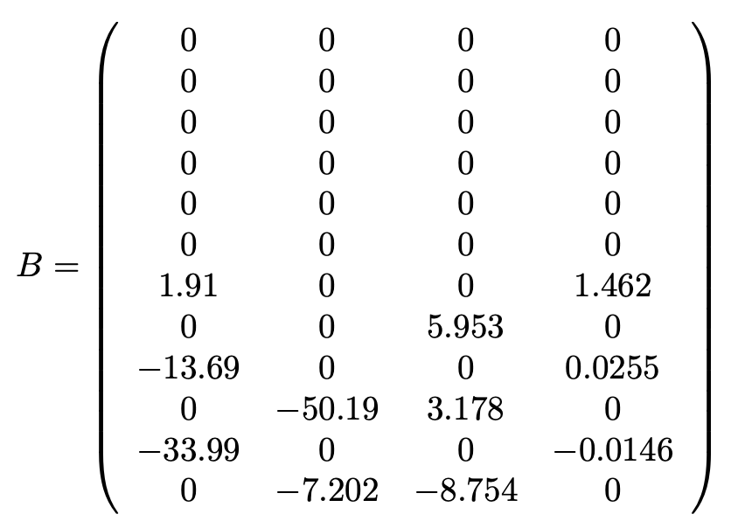
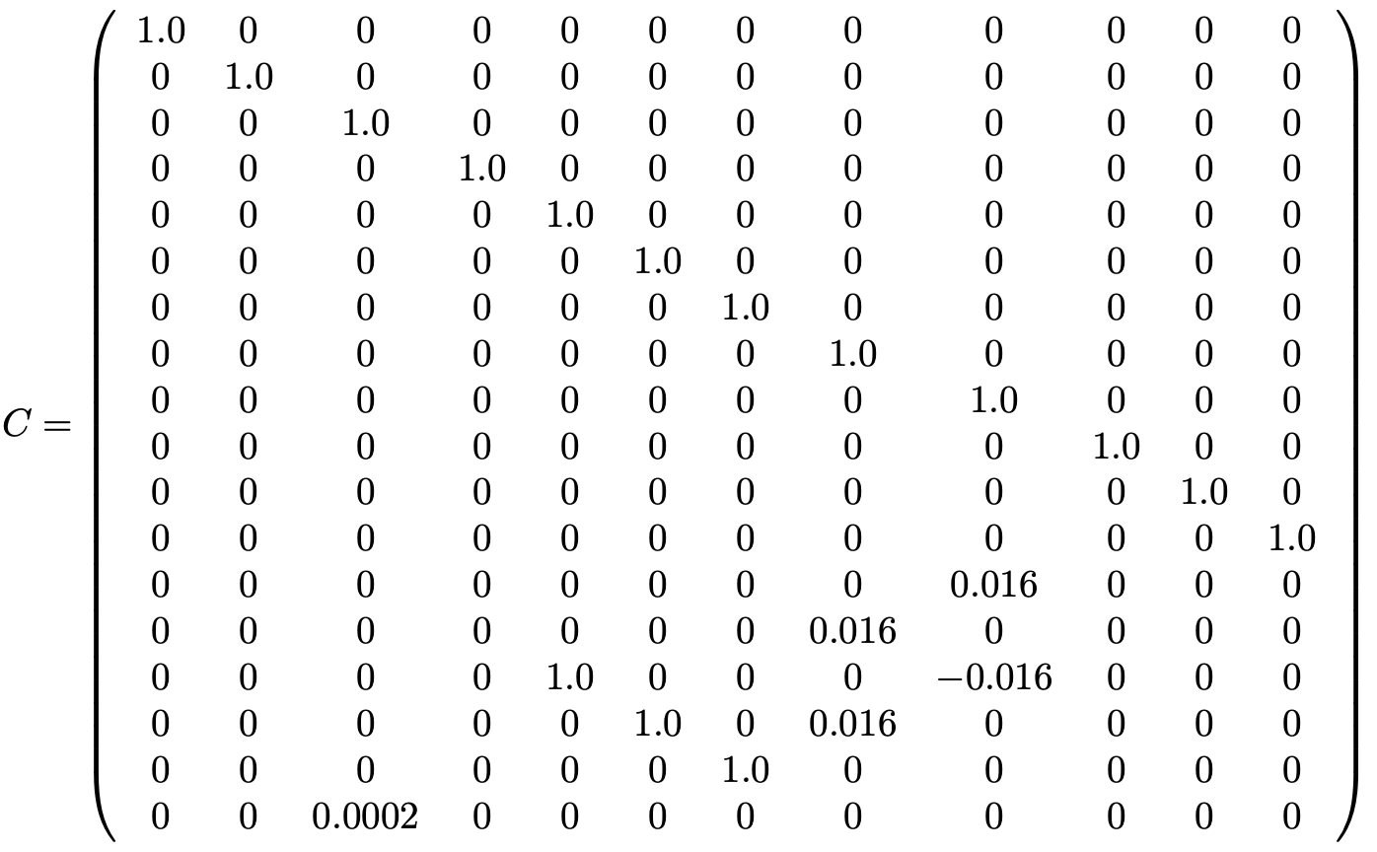
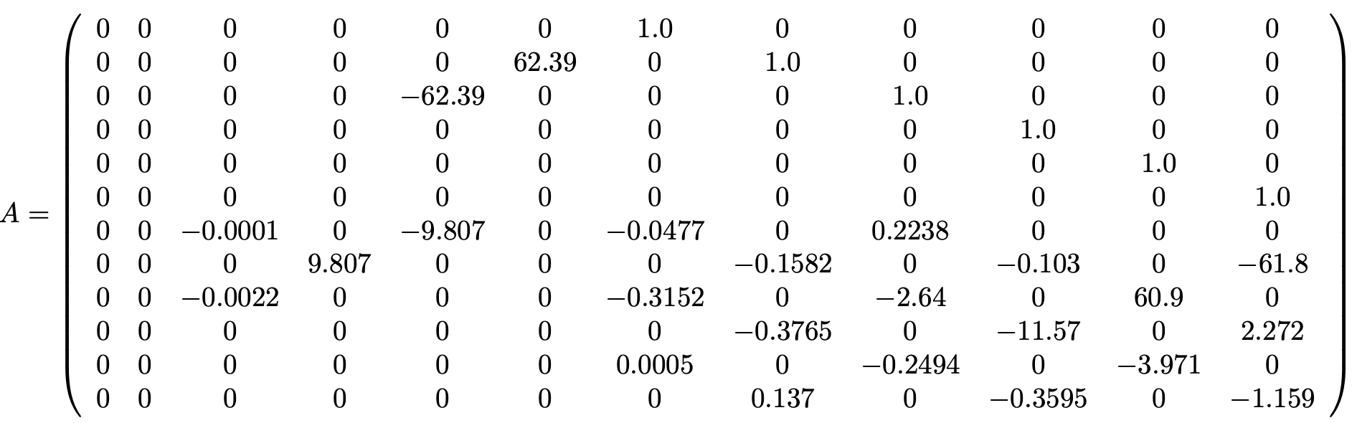
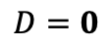
Linearized equations: complete motions
Assumes a small deviation from the previously trimmed states:
Linearization is performed in Matlab to yield the following equations:
$$D=0$$

Slide 13
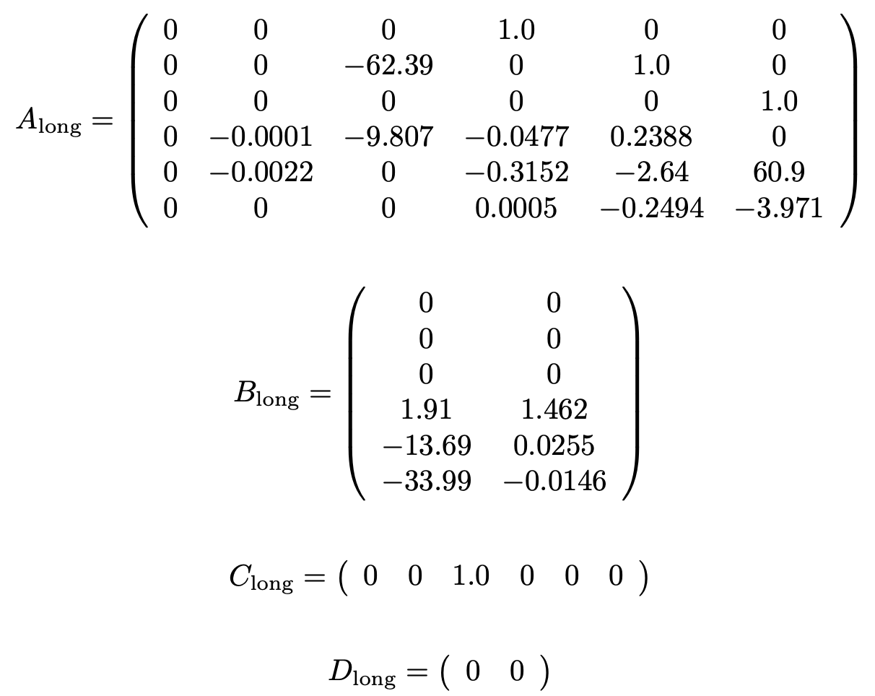
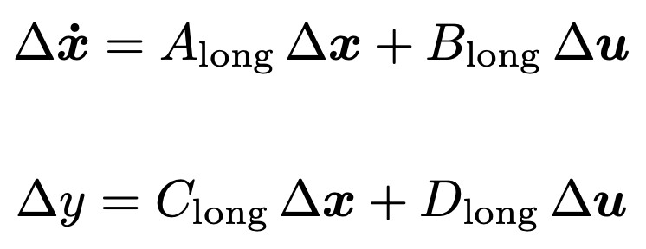
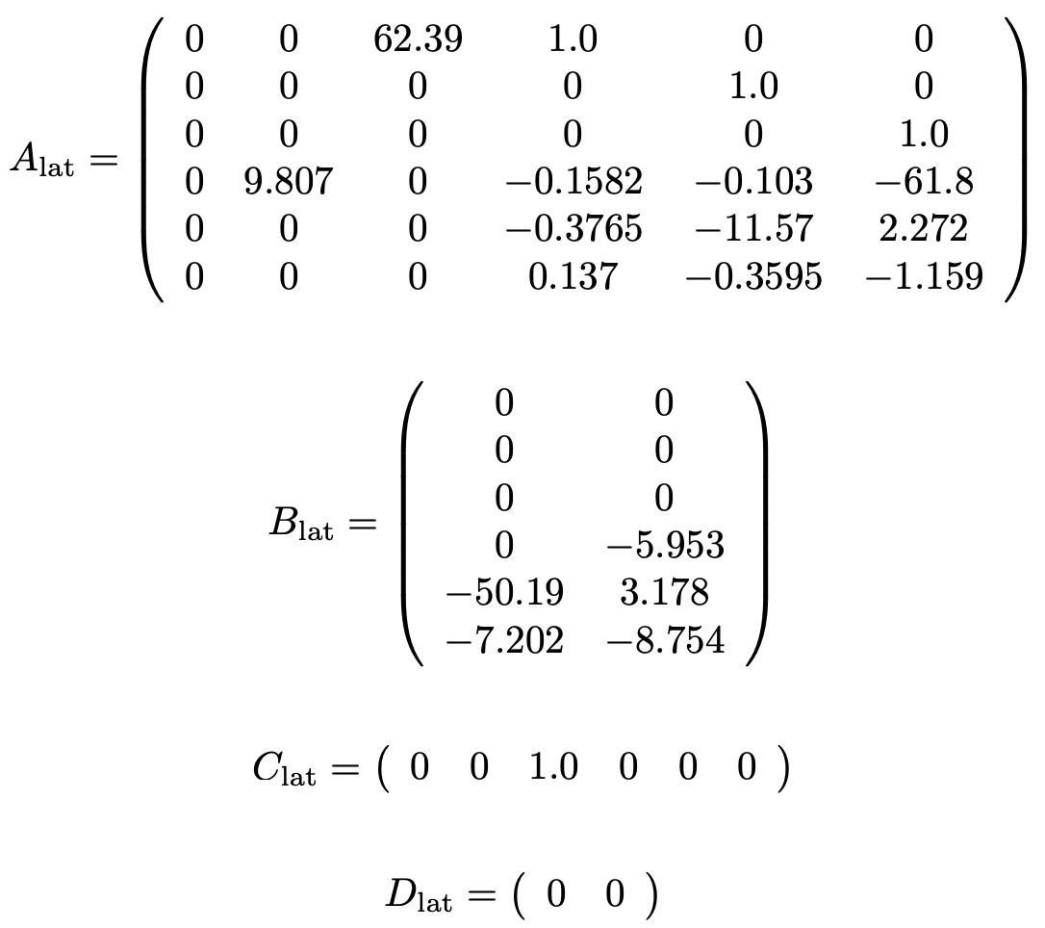
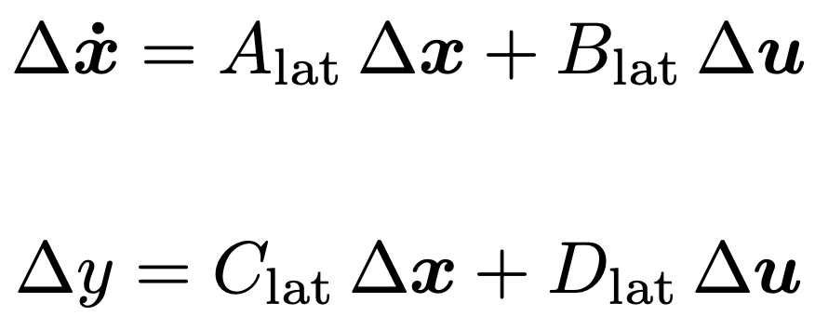
Linearized equations: longitudinal and lateral
The 12 linear equations can be decomposed into two sets of equations:
6 longitudinal equations of motion
6 lateral equations of motion
We focus only on longitudinal equations since they govern the aircraft pitch attitude

Slide 14
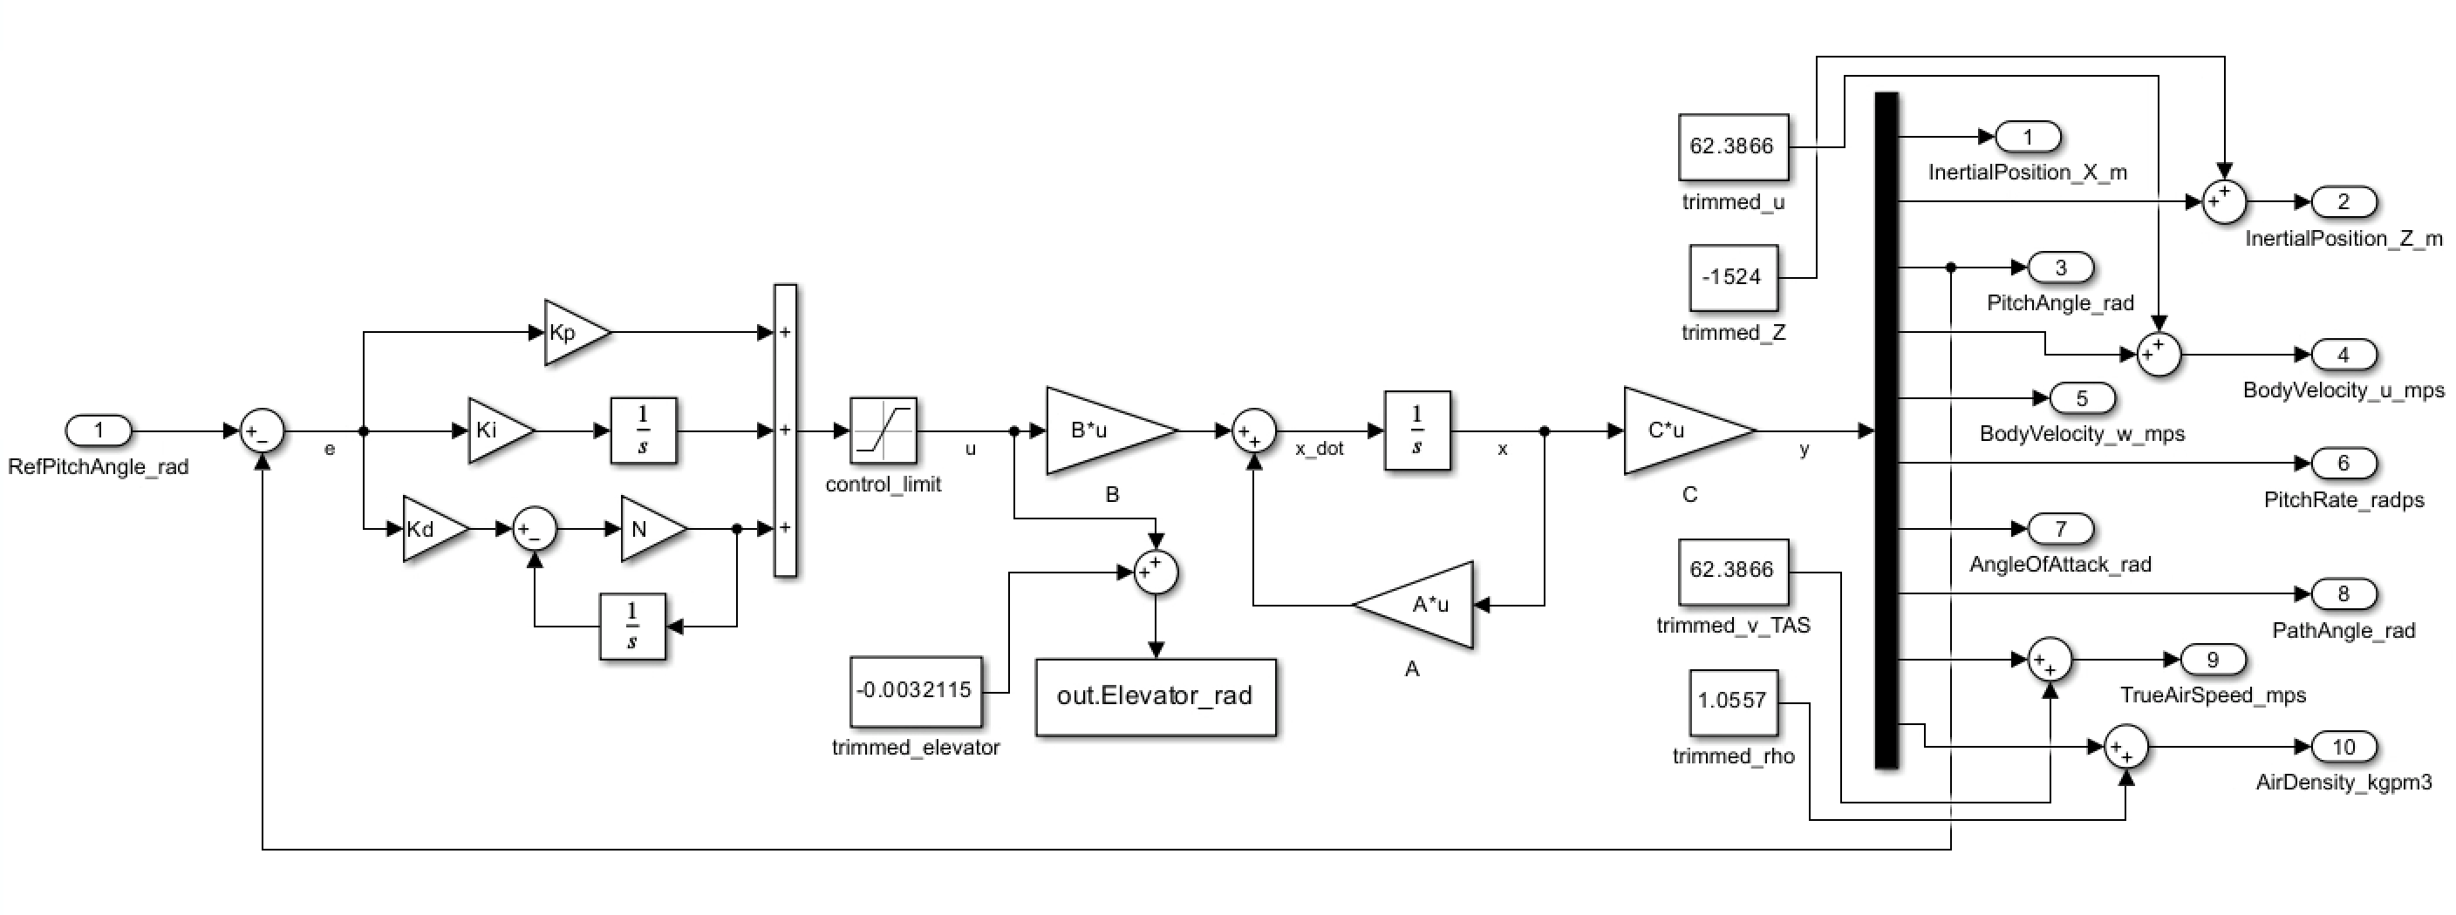
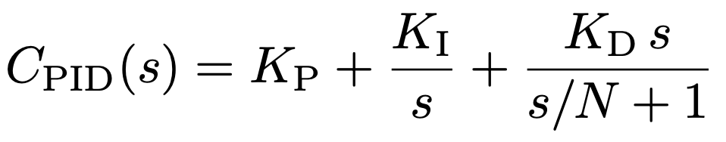
Traditional PID controller with static gain
Standard parallel PID with time filter
Linear plant

Slide 15
Results and Discussion

Slide 16
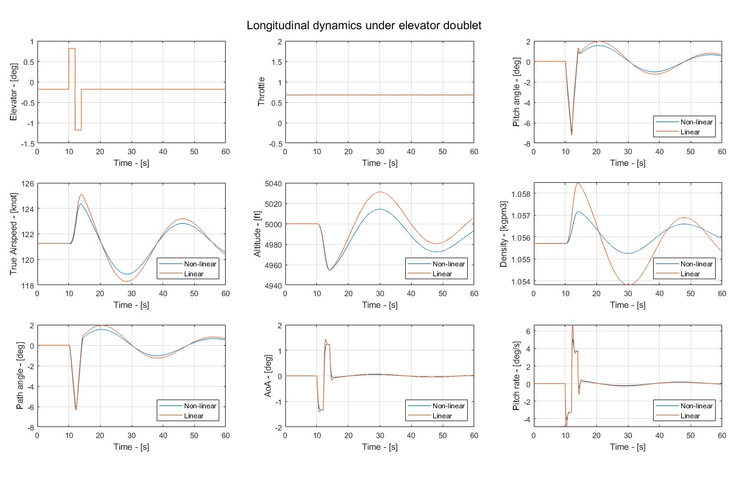
Verification of linear model: elevator doublet

Slide 17
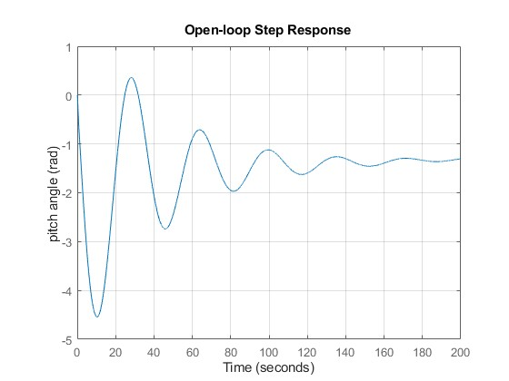
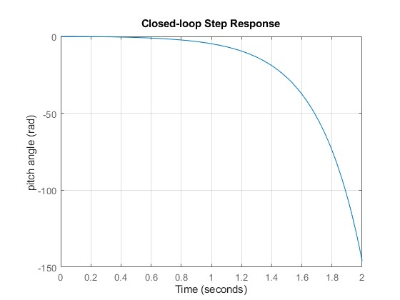
Open-loop and closed-loop responses
The open-loop and closed-loop (with unity feedback) systems are checked
against a step response of 0.2 rad (≈ 11.46 deg).
The open loop is marginally stable and has a large steady-state error. The closed loop with unity feedback makes the system unstable.

Slide 18
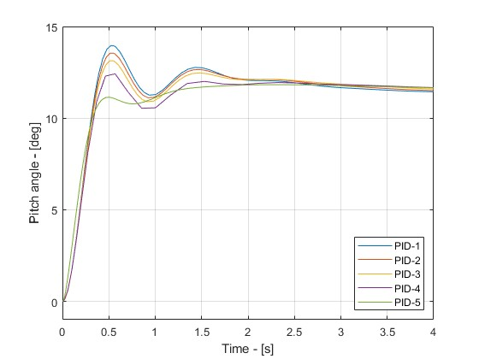
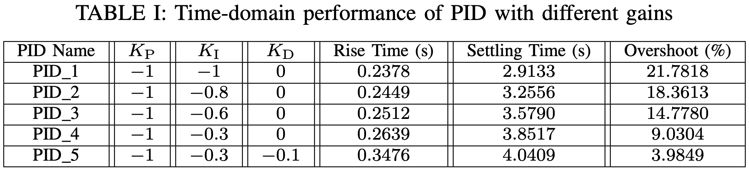
Time-domain performance
Controller design specification
Under a 0.2-radian step input, it should have:
Rise time < 2 seconds
Settling time < 10 seconds
Overshoot < 10%
Steady-state error < 2%
PID_1: fastest rise/settling time, but largest overshoot
PID_5: slowest rise/settling time, but smallest overshoot
PID_4: the compromise which satisfies all the specifications
Might need to compare the requested control input!
PID_5 initially seems to request a very high control input due to the presence of a derivative term.

Slide 19
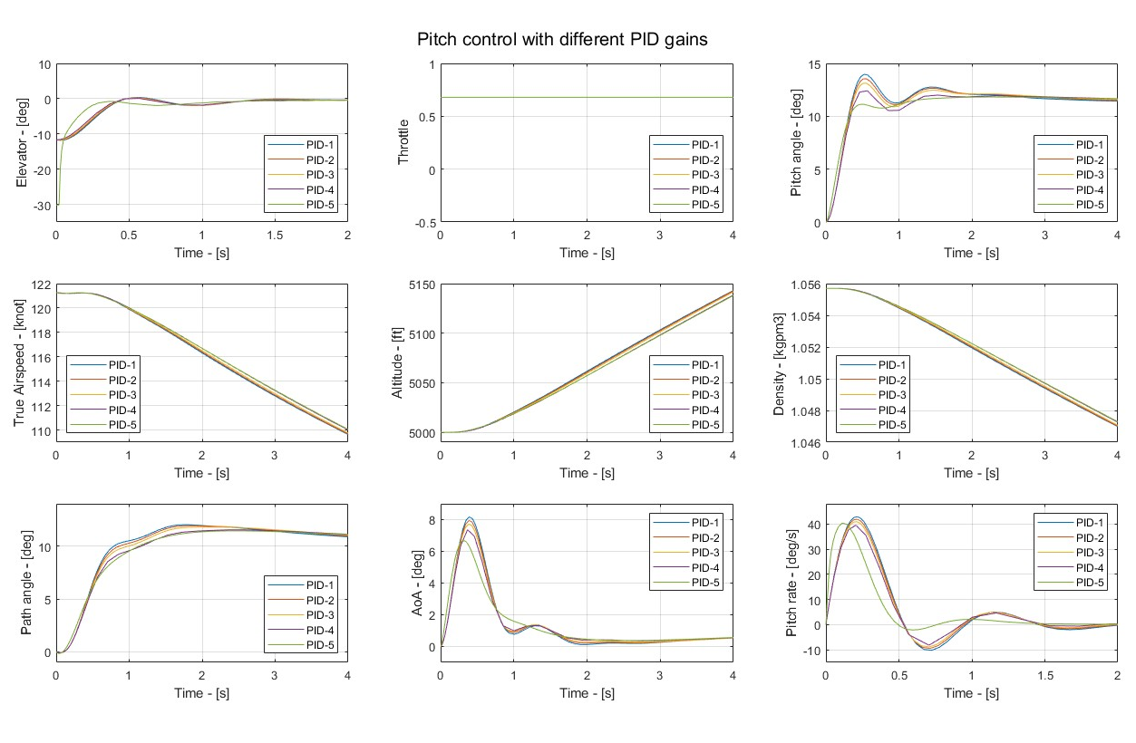
System responses under different PID gains

Slide 20
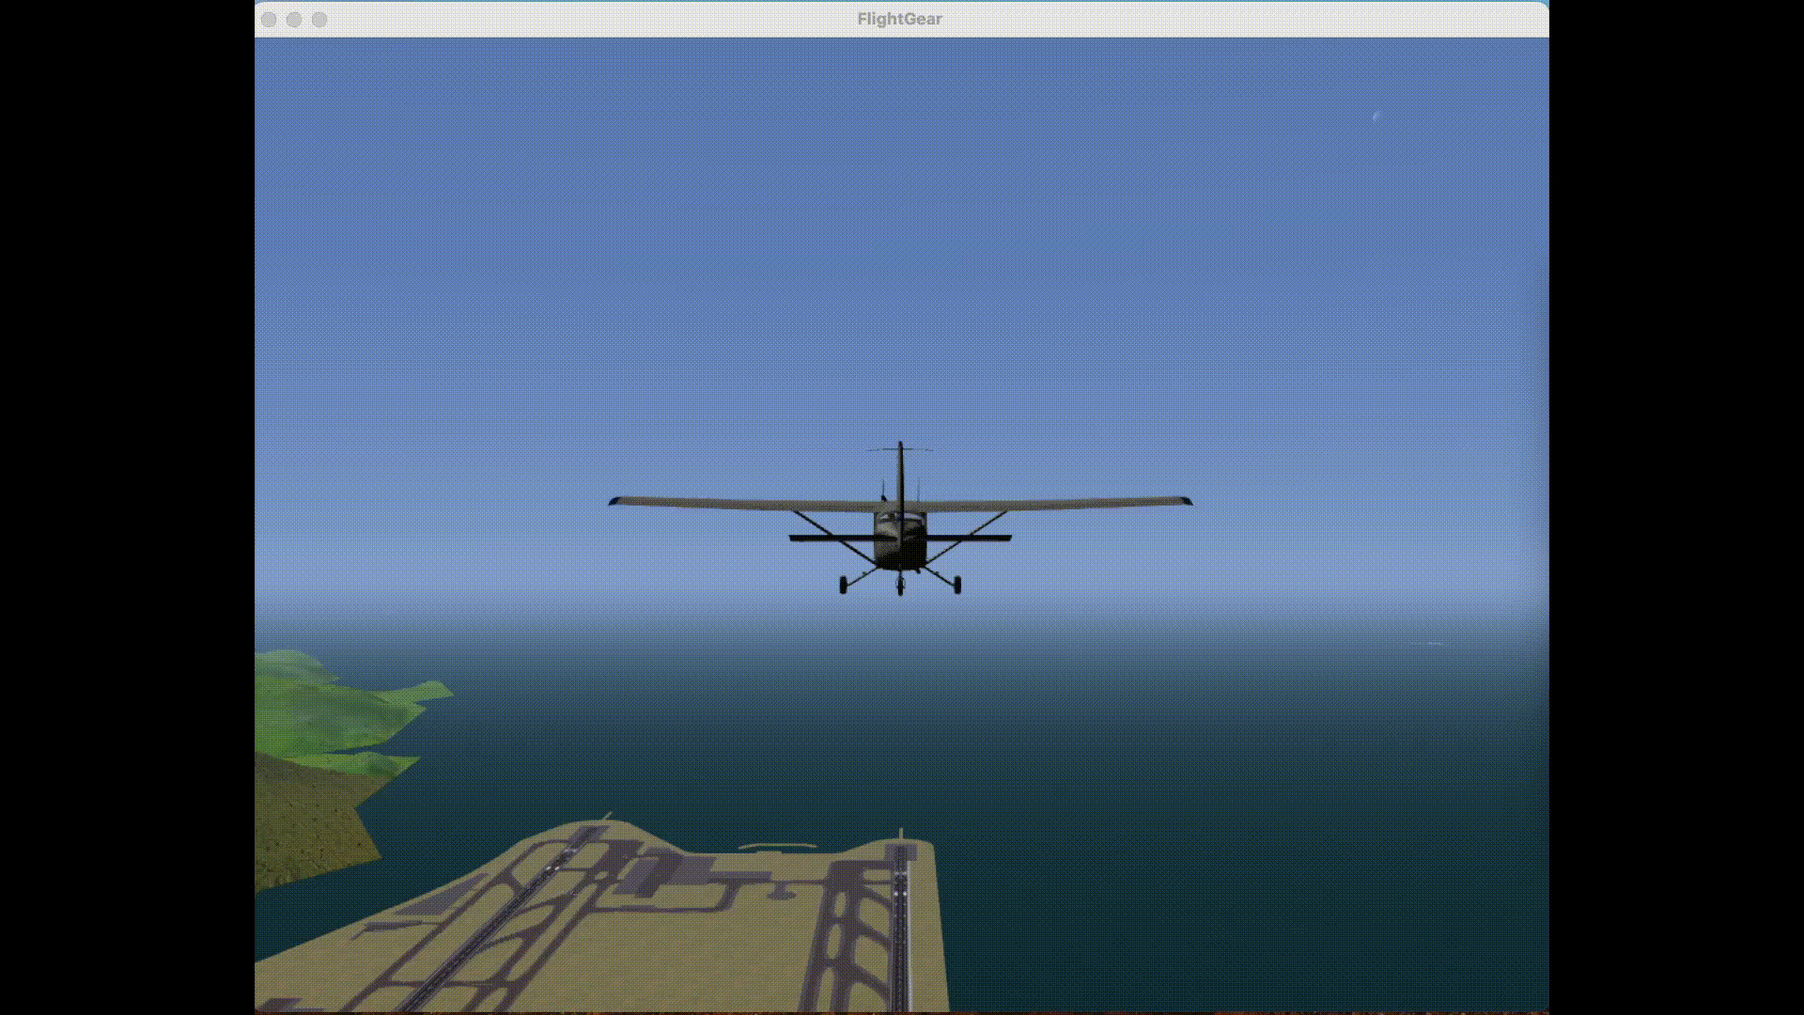
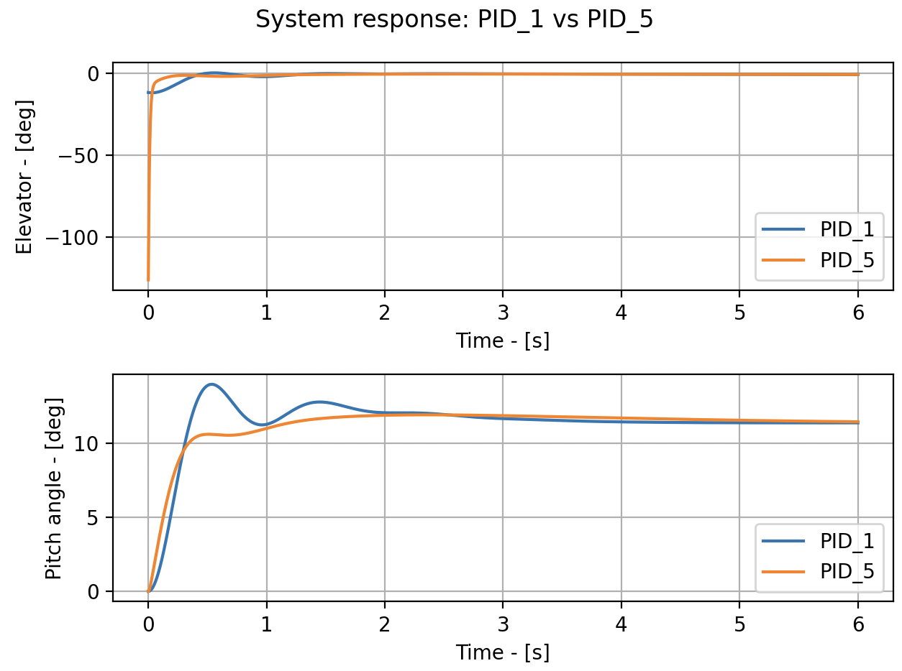
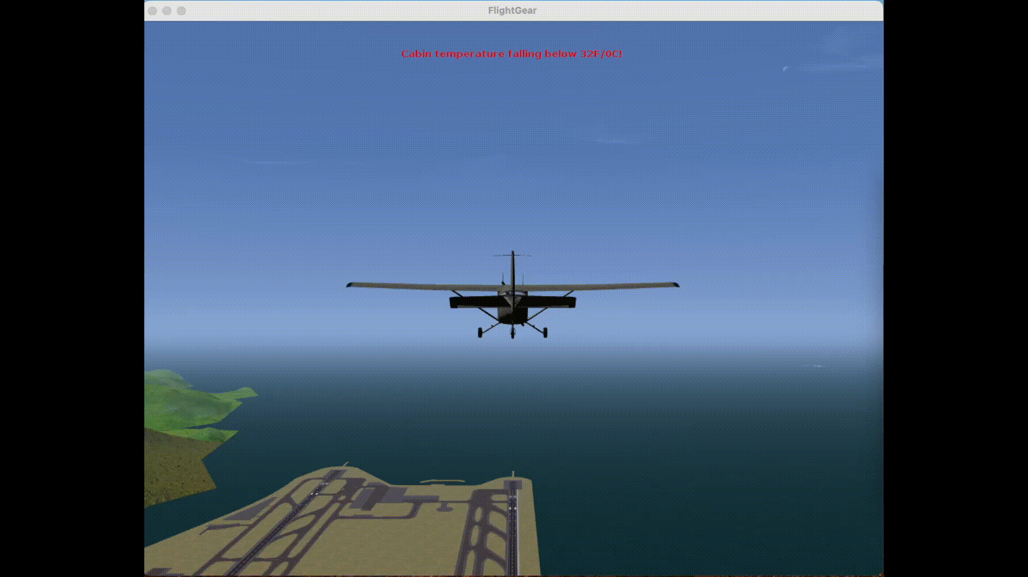
Flightgear visualization
PID_1
PID_5

Slide 21
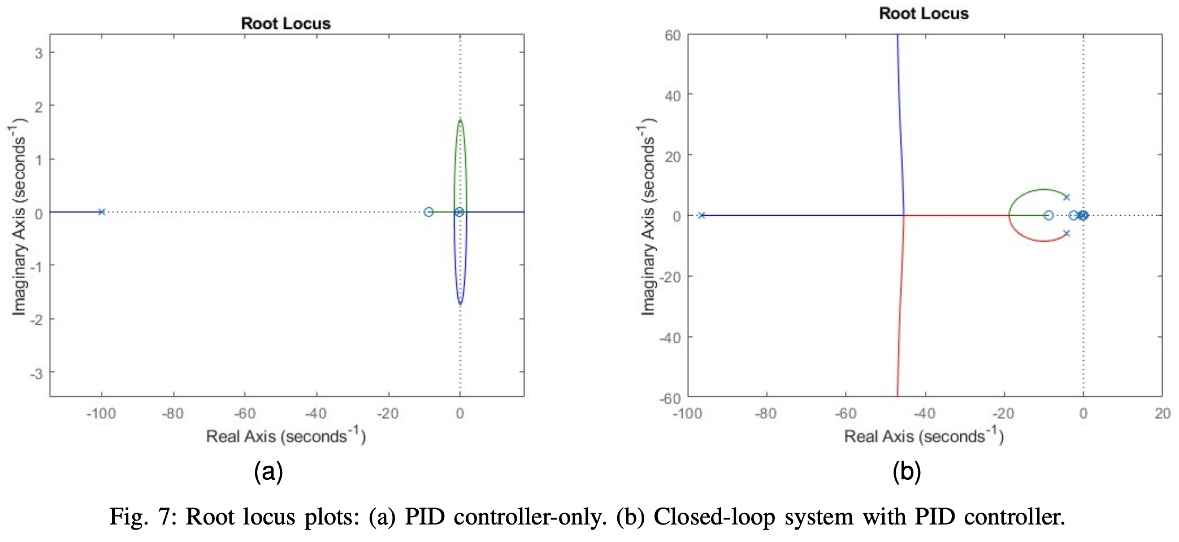
Root locus analysis
Under a 0.2-radian step input, it should have:
The introduction of a PID controller is equivalent to placing two real poles and two real zeros
All the poles of the closed-loop system have negative real-parts → stable system

Slide 22
Work in Progress

Slide 23
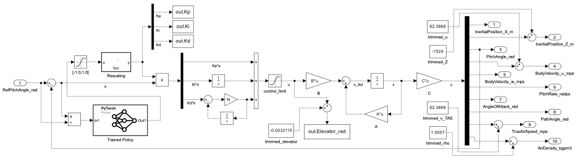
Adaptively-tuned PID via Reinforcement Learning
The university’s Matlab license does not have the RL toolbox license:
implementation must be done in Python, and it takes longer time than expected.
After training in python, the trained policy will be utilized in Simulink as follows.

Slide 24
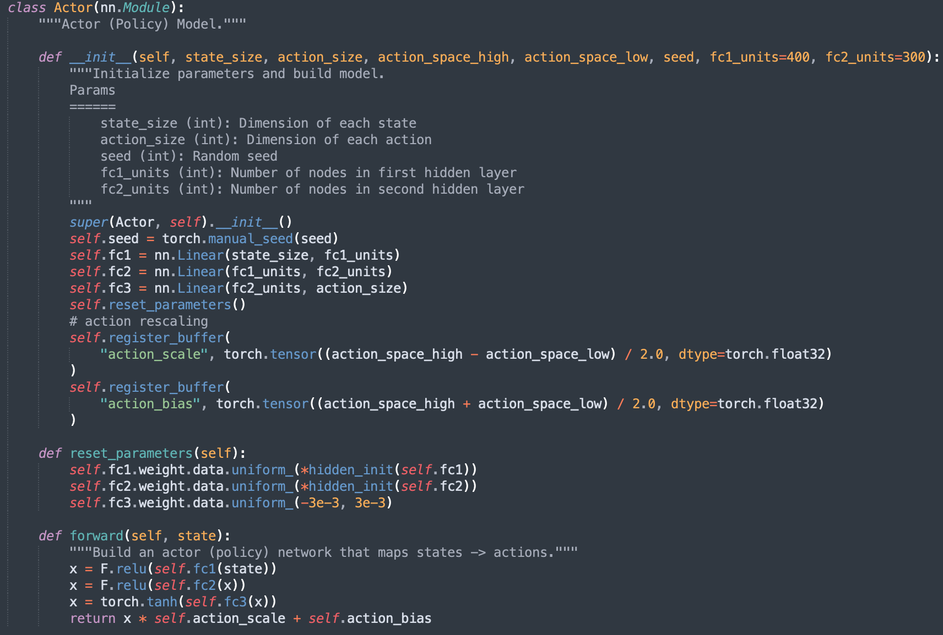
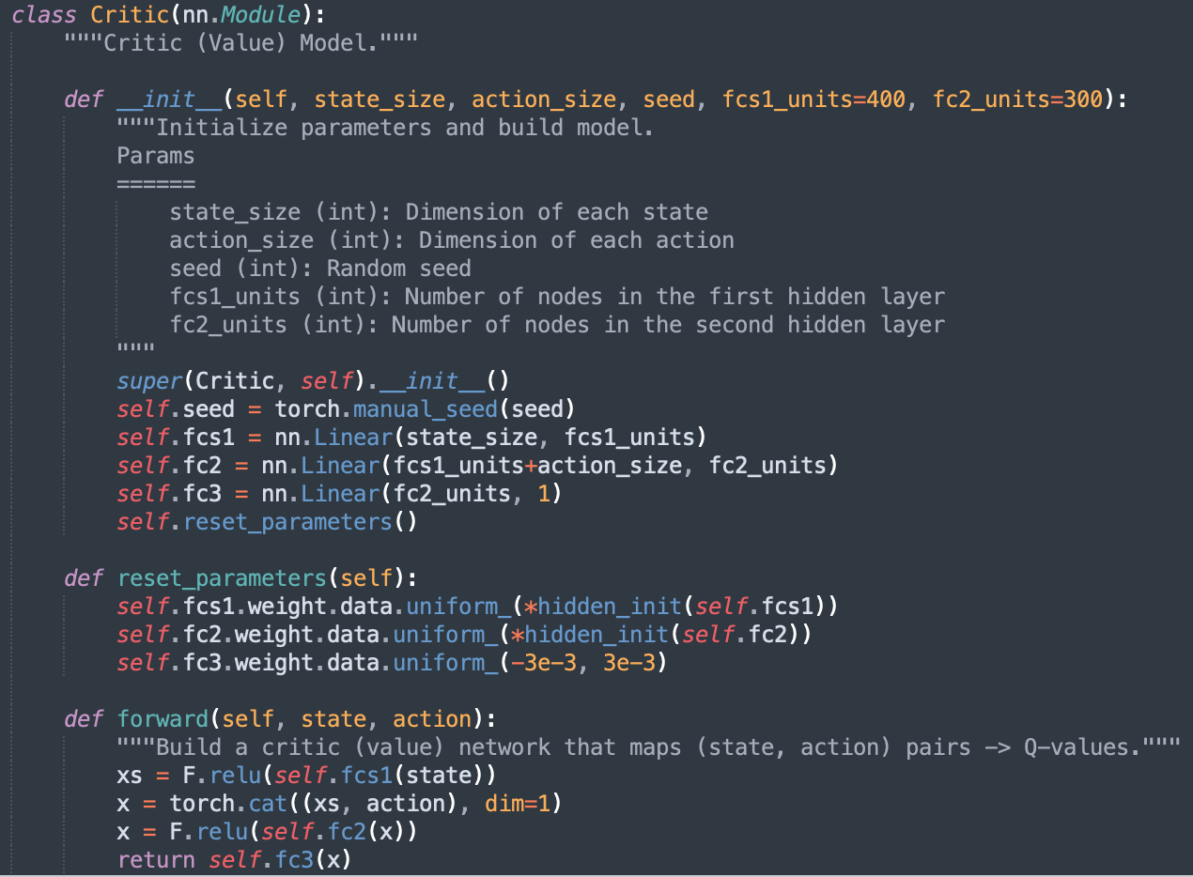
Implementing DDPG algorithm in Python
Work is still ongoing; results will be included in the project's final report.
Actor Network
Critic Network

Slide 25
Thank You.

